Slide 1
MIT Academy of Engineering, Pune
Department of Electronics & Telecommunication Engineering
Melanoma Skin Lesion Processing Using Digital Image Techniques
Submitted By
Students Name | PRN
Vaishnavi Shinde | 202402060016
Shreya Kalaskar | 202402060006
Pushkar Yadav | 202402060017
Aayush Katamkar | 202402060015
Guided by
Dr. Smita Kulkarni

Slide 2
Problem Statement
Melanoma is the most dangerous form of skin cancer, responsible for the majority of skin cancer-related deaths worldwide. Early and accurate detection is critical — when identified at stage I, survival rates exceed 98%; at stage IV, this drops below 20%. However, visual inspection of dermoscopic images is a skilled clinical task subject to inter-observer variability, making computer-aided analysis highly valuable.
Objectives:
To enhance dermoscopic skin images using CLAHE, brightness enhancement, and gamma correction for better lesion visibility.
To remove noise, hair artifacts, and unwanted texture variations using spatial filtering techniques.
To accurately segment melanoma lesion regions from surrounding healthy skin using adaptive threshold segmentation.
To improve lesion continuity and remove small noisy regions using morphological operations and connected component filtering.
To develop a low-cost and interpretable melanoma detection pipeline that does not require GPU processing or large training datasets
To detect melanoma lesion boundaries using contour detection and Canny edge detection techniques.

Slide 3
12-Stage Processing Pipeline
1. Input & Resize (512×512)
7. Adaptive Thresholding
2. Grayscale Conversion
8. Gaussian Smoothing
3. CLAHE Enhancement
9. Morphological Closing
→
4. Brightness Enhancement
10. Morphological Dilation
5. Gamma Correction (γ=1.7)
11. Connected Components
6. Median Filtering
12. Contour + Canny Edges

Slide 4
Phase 1 — Image Enhancement (Stages 1–5)
Stage 1
Resize
All images resized to 512×512 pixels for consistency across the pipeline.
Stage 2
Grayscale
Color → grayscale. Focuses on intensity differences between dark lesion and lighter skin.
Stage 3
CLAHE
Contrast Limited Adaptive Histogram Equalization. Improves local contrast in 8×8 tile regions. clipLimit=3.0 prevents noise amplification.
Stage 4
Brightness +35
Adds +35 brightness offset to increase contrast between lesion and surrounding skin.
Stage 5
Gamma γ=1.7
Non-linear intensity transform. γ>1 darkens already dark pixels more, sharpening the lesion boundary.

Slide 5
⭐ Stage 7 — Adaptive Threshold Segmentation
The core innovation of this pipeline
T = P − ( 0.28 × P )
Where T = threshold value P = histogram peak (dominant skin intensity) 0.28 = scaling factor
Pixel Classification Rule
Why Adaptive?
If I(x,y) < T → Melanoma (255)
If I(x,y) ≥ T → Skin (0)
T calculated from each image's own histogram → works on all skin tones automatically
Comparison with Other Segmentation Methods
Method | Training Data | GPU Needed | Speed
Adaptive Threshold (Ours) | None | No | Fast
K-Means Clustering | None | No | Moderate
Deep Learning (U-Net) | Large Dataset | Yes | Slow (training)

Slide 6
Phase 2 — Filtering & Morphological Processing (Stages 6–10)
Median Filter (Stage 6)
Gaussian Smoothing (Stage 8)
Kernel: 5×5
Replaces pixel with neighborhood median
Removes: noise, hair artifacts, skin texture
Preserves: lesion sharp edges (vs Gaussian)
Kernel: 5×5
Softens rough, jagged binary mask edges
Re-thresholded at 127 to re-binarize
Creates cleaner smoother mask
Morphological Closing (Stage 9)
Morphological Dilation (Stage 10)
= Dilation then Erosion
Elliptical 5×5 kernel
Fills small holes inside lesion
Improves lesion continuity
Elliptical 5×5 kernel, 1 iteration
Expands lesion region outward
Connects nearby disconnected pixels
Strengthens segmented region
Stage 11 — Connected Component Filtering: Removes all white blobs with area < 120 pixels (noise elimination)

Slide 7
Phase 3 — Detection, Edge Analysis & Feature Extraction (Stages 11–12)
Center-Based Contour Selection
Canny Edge Detection (Stage 12)
Formula: d = √[(cx − 256)² + (cy − 256)²]
Select contour with minimum distance d
Assumption: lesion is near image center (dermoscopic standard)
Minimum area filter: 150 pixels
Low threshold: 50 | High threshold: 150
Highlights precise lesion boundary edges
Applied on final lesion binary mask
Reveals irregular edge structures of melanoma
Extracted Morphological Features
Area
Perimeter
Circularity
Pixel count
inside contour
Arc length
of boundary
4π × Area
÷ Perimeter²
Size of lesion
Boundary length
Shape regularity
(1.0 = perfect circle)

Slide 8
Technique Selection & Justification
Stage | Technique Selected | Reason
Enhancement | CLAHE | Improves local contrast, highlights dark pigmented regions
Enhancement | Brightness +35 | Increases intensity gap between lesion and skin
Enhancement | Gamma Correction | Enhances darker regions under uneven illumination
Filtering | Median Filter | Removes noise/hair while preserving lesion boundaries
Segmentation | Adaptive Threshold | Auto-adapts to skin tone & illumination via histogram
Smoothing | Gaussian Smooth | Reduces rough edges before morphological processing
Morphology | Closing + Dilation | Fills holes, connects lesion pixels, improves continuity
Noise Removal | Connected Components | Removes isolated noise blobs (< 120 px area)
Detection | Center Contour | Lesion always near center in dermoscopic images
Edge | Canny Detection | Accurately highlights irregular melanoma boundaries

Slide 9
Advantages & Limitations of the Pipeline
✓ Advantages
✗ Limitations
Adapts automatically to different skin tones
CLAHE + Gamma enhance low-contrast images
Median filter preserves lesion boundaries
No training data or GPU required
Computationally fast — suitable for real-time use
Fully interpretable — every stage visible
Accurate boundaries for clear dermoscopic images
Fails on very low-contrast melanoma lesions
Sensitive to heavy hair artifacts & shadows
Less accurate than deep learning (CNN/U-Net)
Center selection fails if lesion is off-center
Threshold depends on histogram — breaks on noise
Cannot handle multiple overlapping lesions
Reduced accuracy for complex pigmentation
Best for: Clear dermoscopy images • Central lesions • Dark pigmentation • Moderate-to-high contrast • Uniform illumination

Slide 10
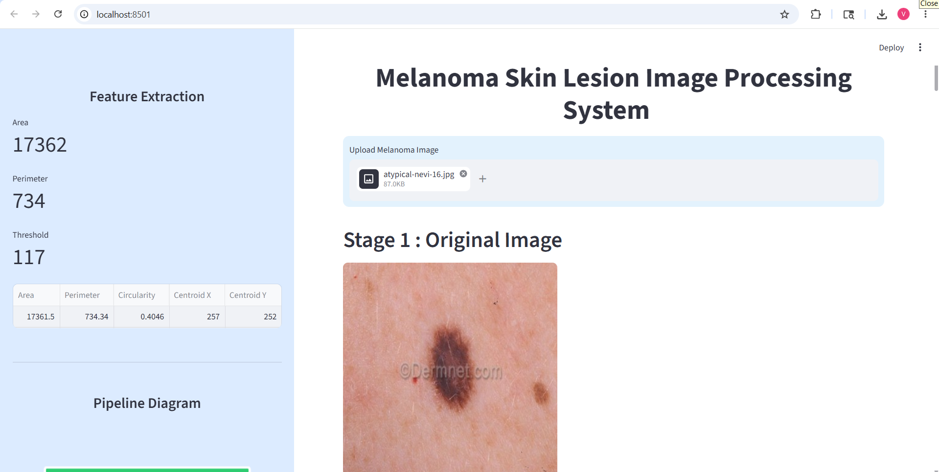
Streamlit Application — UI & Implementation
SIDEBAR
MAIN PANEL
Feature Metrics
• Area (px²)
• Perimeter (px)
• Circularity
• Threshold value
Feature DataFrame
Pipeline Block Diagram
Title: Melanoma Skin Lesion Image Processing System
File Uploader: JPG / JPEG / PNG
12 Output Stages displayed with headers
Histogram comparison (Original vs Enhanced)
Final contour image with 'Melanoma' label
Final segmented lesion (color on black background)

Slide 11
Conclusion
A computationally simple, cost-effective, and real-time melanoma segmentation system — built without any machine learning or GPU.
✓
CLAHE + Gamma + Brightness enhance lesion visibility in low-contrast images
✓
Adaptive threshold auto-adapts to skin tone — no fixed parameters
✓
Morphological + Component filtering produce clean lesion masks
✓
Contour + Canny detect precise lesion boundaries
✓
Extracts Area, Perimeter, Circularity for clinical morphological analysis
DSIP Project — Melanoma Skin Lesion Detection System

